Slide 1
Greedy algorithms 1 Scheduling
CS240 Spring 2024
Rui Fan

Slide 2
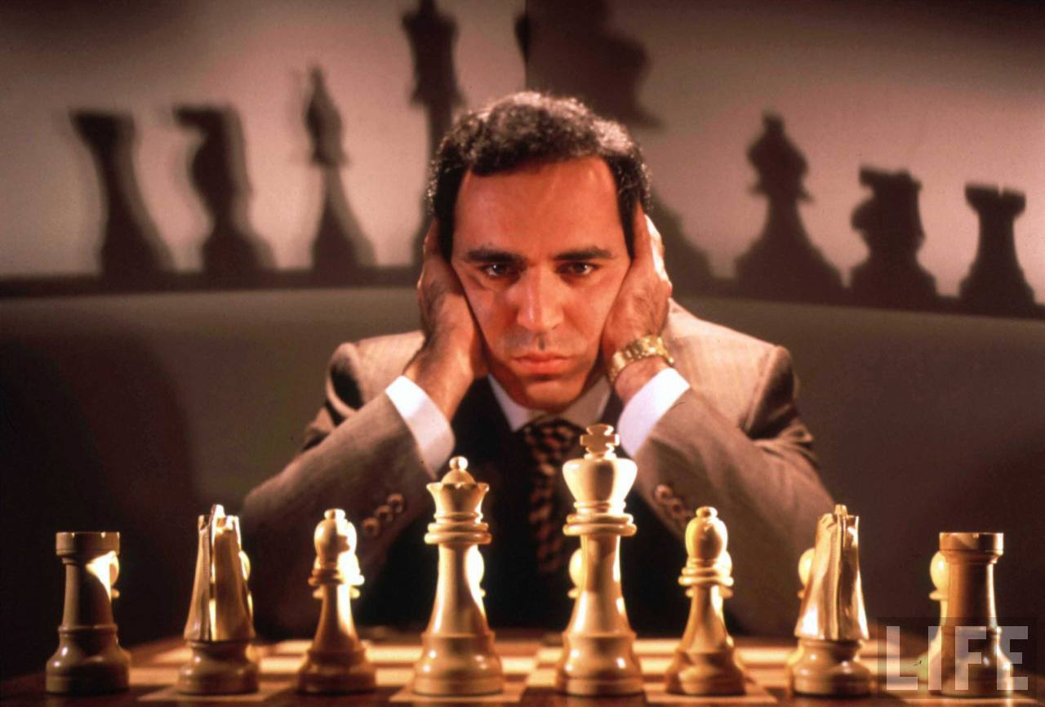
Greedy algorithms
Make the best choice at the moment.
No planning ahead. “Short-sighted”.
Once choice made, it’s fixed.
No take-backs.
Cons Doesn’t always find optimal answer.
Pros Simple and fast. Sometimes optimal.

Slide 3
Overview
Selecting breakpoints
Coin change
Interval scheduling
Interval coloring
Scheduling to minimizing lateness

Slide 4
Selecting Breakpoints
Selecting breakpoints.
Road trip from Princeton to Palo Alto along fixed route.
Refueling stations at certain points along the way.
Fuel capacity = C.
Goal: makes as few refueling stops as possible.
Greedy algorithm. Go as far as you can before refueling.
C
C
C
C
Princeton
C
C
C
Palo Alto
1
2
3
4
5
6
7
Notes:
applications: communication server sending information in chunks of size at most C

Slide 5
Selecting Breakpoints: Greedy Algorithm
Truck driver's algorithm.
Implementation.
O(n log n) to sort.
O(n) time for while loop.
Sort breakpoints so that: 0 = b₀ < b₁ < b₂ < ... < b_{n} = L
S ← {0}
x ← 0
while (x ≠ b_{n})
let p be largest integer such that b_{p} ≤ x + C
if (b_{p} = x)
return "no solution"
x ← b_{p}
S ← S ∪ {p}
return S
breakpoints selected
current location

Slide 6
Selecting Breakpoints: Correctness
Theorem. Greedy algorithm is optimal.
Pf. (by contradiction)
Assume greedy is not optimal, and let's see what happens.
Let 0 = g₀ < g₁ < . . . < g_{p} = L denote set of breakpoints chosen by greedy.
Let 0 = f₀ < f₁ < . . . < f_{q} = L denote set of breakpoints in an optimal solution with f₀ = g₀, f₁= g₁ , . . . , f_{r} = g_{r} for largest possible value of r.
Note: g_{r+1} > f_{r+1} by greedy choice of algorithm.
g₀
g₁
g₂
g_{r}
g_{r+1}
Greedy:
OPT:
. . .
f₀
f₁
f₂
f_{r}
f_{r+1}
f_{q}
why doesn't optimal solution drive a little further?

Slide 7
Selecting Breakpoints: Correctness
Theorem. Greedy algorithm is optimal.
Pf. (by contradiction)
Assume greedy is not optimal, and let's see what happens.
Let 0 = g₀ < g₁ < . . . < g_{p} = L denote set of breakpoints chosen by greedy.
Let 0 = f₀ < f₁ < . . . < f_{q} = L denote set of breakpoints in an optimal solution with f₀ = g₀, f₁= g₁ , . . . , f_{r} = g_{r} for largest possible value of r.
Note: g_{r+1} > f_{r+1} by greedy choice of algorithm.
g₀
g₁
g₂
g_{r}
g_{r+1}
Greedy:
OPT:
. . .
f₀
f₁
f₂
f_{r}
f_{q}
another optimal solution has one more breakpoint in common ⇒ contradiction

Slide 8







Coin Changing
Goal. Given currency denominations: 1, 5, 10, 25, 100 (penny, nickel, dime, quarter, dollar) devise a method to pay amount to customer using fewest number of coins.
Ex: 34¢.
Cashier's algorithm. At each iteration, add coin of the largest value that does not take us past the amount to be paid.
Ex: $2.89.
Notes:
most of us solve this kind of problem every day without thinking twice, unconsciously using an obvious greedy algorithm
http://www.frbatlanta.org/publica/brochure/fundfac/html/coinfaces.html

Slide 9
Coin-Changing: Greedy Algorithm
Cashier's algorithm. At each iteration, add coin of the largest value that does not take us past the amount to be paid.
Q. Is cashier's algorithm optimal?
Sort coins denominations by value: c₁ < c₂ < … < c_{n}.
S ← φ
while (x ≠ 0) {
let k be largest integer such that c_{k} ≤ x
if (k = 0)
return "no solution found"
x ← x - c_{k}
S ← S ∪ {k}
}
return S
coins selected
Notes:
takes O(n log n) + |S| where S is the number of coins taken by greedy
Note: can be sped up somewhat by using integer division

Slide 10

Coin-Changing: Analysis of Greedy Algorithm
Theorem. Greed is optimal for U.S. coinage: 1, 5, 10, 25, 100.
Pf. (by induction on x)
Consider optimal way to change c_{k} ≤ x < c_{k+1} : greedy takes coin k.
We claim that any optimal solution must also take coin k.
if not, it needs enough coins of type c₁, …, c_{k-1} to add up to x
table below indicates no optimal solution can do this
Problem reduces to coin-changing x - c_{k} cents, which, by induction, is optimally solved by greedy algorithm. ▪
k
c_{k}
All optimal solutions must satisfy
Max value of coins 1, 2, …, k-1 in any OPT
Opt must have $p≤4$, because if $p≥5$, can replace 5 p with 1 n.
Opt must have $n≤1$, because if $n≥2$, can replace with one dime, etc.
So if don’t use $c_{k}$, then must use $c_{1},…,c_{k−1}$, and these must add up to $≥x≥c_{k}$.
By case analysis, we see coins of type $c_{1},…,c_{k−1}$ never add up to $≥c_{k}$.
1
1
P ≤ 4
-
2
5
N ≤ 1
4
3
10
N + D ≤ 2
4 + 5 = 9
4
25
Q ≤ 3
20 + 4 = 24
5
100
no limit
75 + 24 = 99
Notes:
P = pennies, N = nickels, D = dimes, Q = quarters
In class: derive RMB table on whiteboard

Slide 11
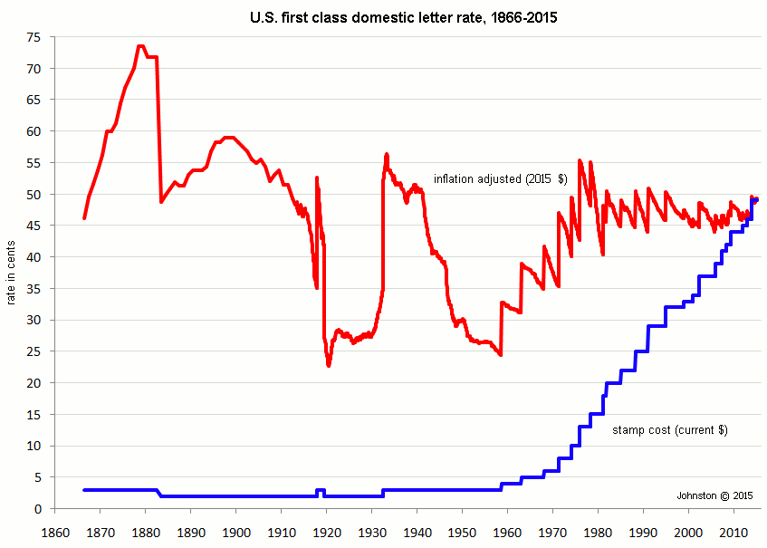
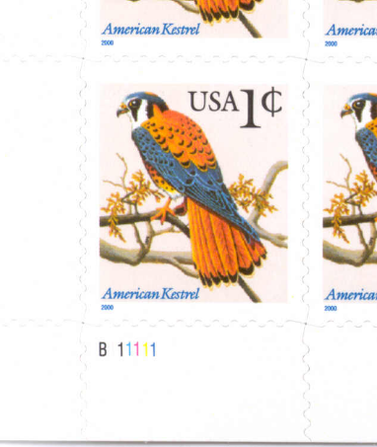
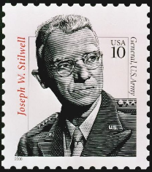

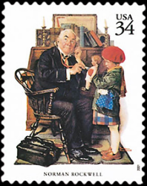




Coin-Changing: Analysis of Greedy Algorithm
Observation. Greedy algorithm is sub-optimal for US postal denominations: 1, 10, 21, 34, 70, 100, 350, 1225, 1500.
Counterexample. 140¢.
Greedy: 100, 34, 1, 1, 1, 1, 1, 1.
Optimal: 70, 70.
Notes:
note: may not even lead to *feasible* solution if c_1 > 1!
Ex. C = {7, 8, 9}, x = 15
Student Q: how to design denominations s.t. greedy is optimal or not optimal
My A: dunno, but probably we need to use the table

Slide 12
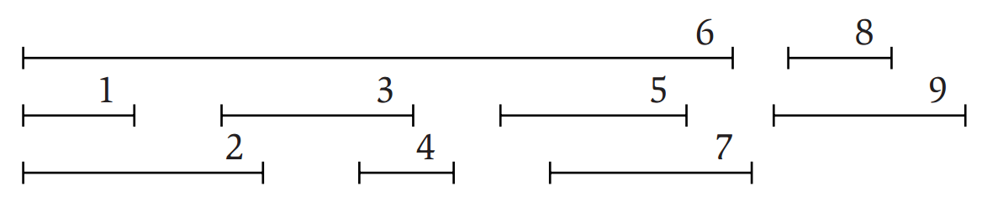
Interval scheduling
Algorithm Design
Kleinberg, Tardos
Given a set of intervals, pick the largest number of nonoverlapping ones.
Each interval given by a start and finishing time.
Models use of a shared resource.
Ex 9 people want to use a room. Different people want to use it at different times. Let max number of people use room.

Slide 13
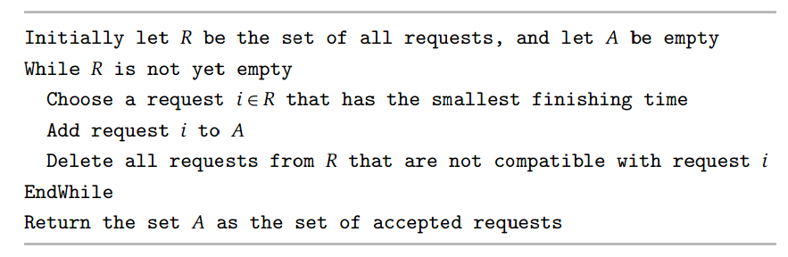
A greedy algorithm
Let’s pick the intervals from left to right.
Intuition Since can’t pick a new interval until the previous one ends, want to pick intervals that end as quickly as possible.
So we sort the intervals by finishing times. Then keep selecting earliest finishing one that doesn’t overlap previous selected interval.

Slide 14
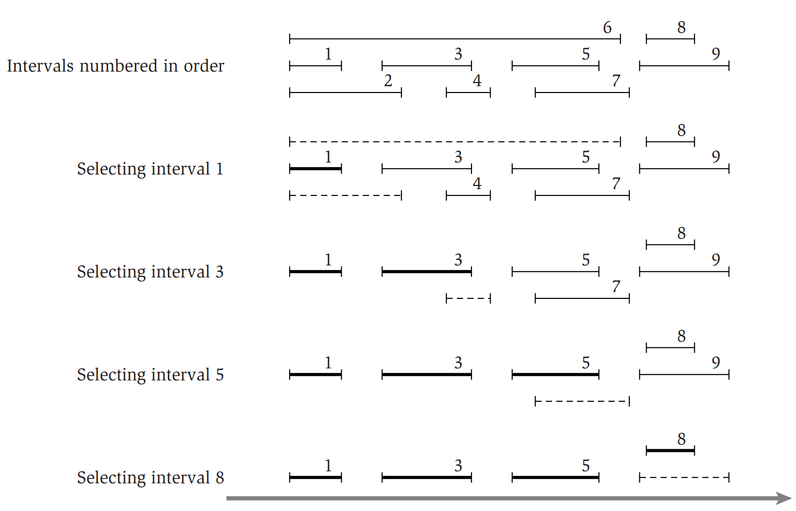
A greedy algorithm
Algorithm Design
Kleinberg, Tardos

Slide 15
Correctness
We’ll compare algorithm’s solution S to an optimal solution T.
Can have S≠T, since there may be several optimal solutions.
Def Let s_{k} and t_{k} be k’th interval in S and T, resp.
Def let fin(i) be finishing time of an interval i.
Claim fin(s_{k}) ≤ fin(t_{k}) for all k.
Proof By induction. True for k=1 since s_{k} is interval with min fin time.
Suppose true for < k, i.e. fin(s_{k-1}) ≤ fin(t_{k-1}).
Then {intervals not intersecting s_{k-1} and finishing after s_{k-1}} ⊇ {intervals not intersecting t_{k-1} and finishing after t_{k-1}}.
By the algorithm, s_{k} is earliest finishing interval in the first set.
t_{k} is some interval in the latter set.
So fin(s_{k}) ≤ fin(t_{k}).
Corollary S has at least as many intervals as T, i.e. S is optimal.
algorithm’s solution
an optimal solution

Slide 16
Analysis
If there are n intervals, sorting the intervals takes O(n log n) time.
Then we go through the intervals in order of finishing times.
For each interval, check if it intersects last selected one, and select it if it doesn’t.
Takes O(n) time.
Total O(n log n) time.

Slide 17
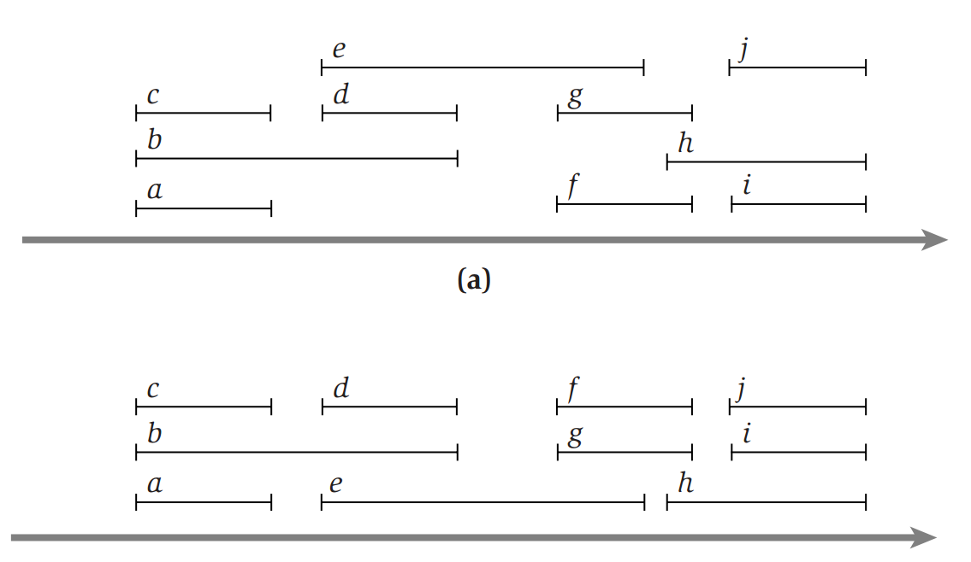
Interval coloring problem
In interval scheduling, we scheduled the max number of intervals on one resource.
In interval coloring, we need to schedule all the intervals on some number of resources.
Intervals on the same resource cannot overlap.
Goal Minimize the number of resources used.
Example application is to schedule people who need to use a room in the min number of rooms.
All intervals scheduled using 4 resources
All intervals scheduled using 3 resources

Slide 18
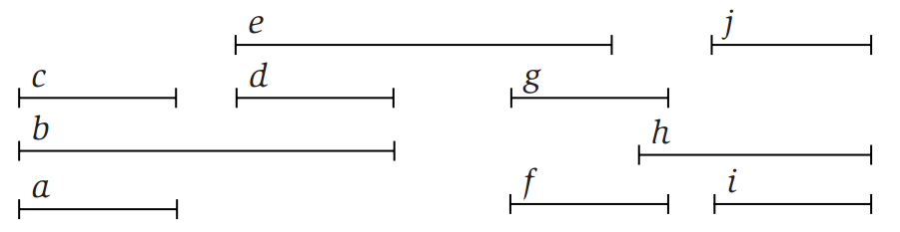
Optimality criterion
Observation Suppose k intervals intersect at some time point. Then the optimal schedule needs at least k resources.
Since intervals on same resource can’t overlap, then the k intersecting intervals need to be assigned to k different resources in any solution.
Def Depth of a set of intervals is the max number of intervals that intersect at any time.
These intervals have depth 3
optimal schedule needs at least 3 resources

Slide 19
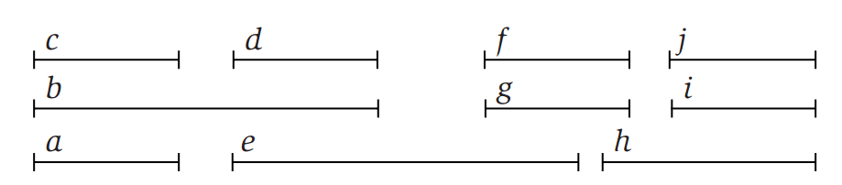
Optimality criterion
Corollary Let d be the depth of a set of intervals, and suppose we find a schedule using d resources. Then the schedule is optimal.
By the observation, any schedule needs at least d resources. Since our schedule uses d resources, it’s optimal.
Since depth is 3, this schedule is optimal

Slide 20
A greedy algorithm
Sweep through intervals in order of increasing start time.
Break ties arbitrarily.
For each interval, assign it to smallest resource not already assigned to an intersecting interval.

Slide 21
Correctness
Claim Let the set of intervals have depth d. Then the algorithm uses d resources.
Proof Suppose algorithm is processing some interval s. Then ≤ d-1 intervals intersect s.
So ≤ d-1 resources assigned to these intervals.
So s can be assigned some resource ≤ d.
Corollary The algorithm is optimal
Follows by the optimality criterion.

Slide 22
Scheduling to Minimizing Lateness
Minimizing lateness problem.
Single resource processes one job at a time.
Job j requires t_{j} units of processing time and is due at time d_{j}.
If j starts at time s_{j}, it finishes at time f_{j} = s_{j} + t_{j}.
Lateness: _{j} = max { 0, f_{j} - d_{j} }.
Goal: schedule all jobs to minimize maximum lateness L = max _{j}.
Ex:
1
2
3
4
5
6
t_{j}
3
2
1
4
3
2
d_{j}
6
8
9
9
14
15
lateness = 2
max lateness = 6
d₃ = 9
d₂ = 8
d₆ = 15
d₁ = 6
d₅ = 14
d₄ = 9
0
1
2
3
4
5
6
7
8
9
10
11
12
13
14
15
Notes:
Note: finding a maximal size subset of jobs that meet deadline is NP-hard.

Slide 23
Minimizing Lateness: Greedy Algorithms
Greedy template. Consider jobs in some order.
[Shortest processing time first] Consider jobs in ascending order of processing time t_{j}.
[Earliest deadline first] Consider jobs in ascending order of deadline d_{j}.
[Smallest slack] Consider jobs in ascending order of slack d_{j} - t_{j}.

Slide 24
Minimizing Lateness: Greedy Algorithms
Greedy template. Consider jobs in some order.
[Shortest processing time first] Consider jobs in ascending order of processing time t_{j}.
[Smallest slack] Consider jobs in ascending order of slack d_{j} - t_{j}.
1
2
t_{j}
1
10
counterexample
d_{j}
100
10
1
2
t_{j}
1
10
counterexample
d_{j}
2
10

Slide 25
Minimizing Lateness: Greedy Algorithm
Greedy algorithm. Earliest deadline first.
Sort n jobs by deadline so that d₁ ≤ d₂ ≤ … ≤ d_{n}
t ← 0
for j = 1 to n
Assign job j to interval [t, t + t_{j}]
s_{j} ← t, f_{j} ← t + t_{j}
t ← t + t_{j}
output intervals [s_{j}, f_{j}]
1
2
3
4
5
6
t_{j}
3
2
1
4
3
2
d_{j}
6
8
9
9
14
15
max lateness = 1
d₁ = 6
d₂ = 8
d₃ = 9
d₄ = 9
d₅ = 14
d₆ = 15
0
1
2
3
4
5
6
7
8
9
10
12
13
14
15

Slide 26
Minimizing Lateness: No Idle Time
Observation. There exists an optimal schedule with no idle time.
Observation. The greedy schedule has no idle time.
d = 4
d = 6
d = 12
0
1
2
3
4
5
6
7
8
9
10
11
d = 4
d = 6
d = 12
0
1
2
3
4
5
6
7
8
9
10
11
Notes:
"machine not working for some reason, yet work still to be done"

Slide 27
Minimizing Lateness: Inversions
Def. An inversion in schedule S is a pair of jobs i and j such that: i < j but j scheduled before i.
Observation. Greedy schedule has no inversions.
Observation. If a schedule (with no idle time) has an inversion, it has one with a pair of inverted jobs scheduled consecutively.
inversion
before swap
j
i
Notes:
Recall: jobs sorted in ascending order of due dates

Slide 28
Minimizing Lateness: Inversions
Def. An inversion in schedule S is a pair of jobs i and j such that: i < j but j scheduled before i.
Claim. Swapping two adjacent, inverted jobs reduces the number of inversions by one and does not increase the max lateness.
Pf. Let  be the lateness before the swap, and let ' be it afterwards.
'_{k} = _{k} for all k ≠ i, j
'_{i} ≤ _{i}
If job j is late:
inversion
f_{i}
before swap
j
i
after swap
i
j
f'_{j}

Slide 29
Minimizing Lateness: Analysis of Greedy Algorithm
Theorem. Greedy schedule S is optimal.
Pf. Define S* to be an optimal schedule that has the fewest number of inversions, and let's see what happens.
Can assume S* has no idle time.
If S* has no inversions, then S = S*.
If S* has an inversion, let i-j be an adjacent inversion.
swapping i and j does not increase the maximum lateness and strictly decreases the number of inversions
this contradicts definition of S* ▪

